Slide 1


Blake Bagley Demo

Slide 2
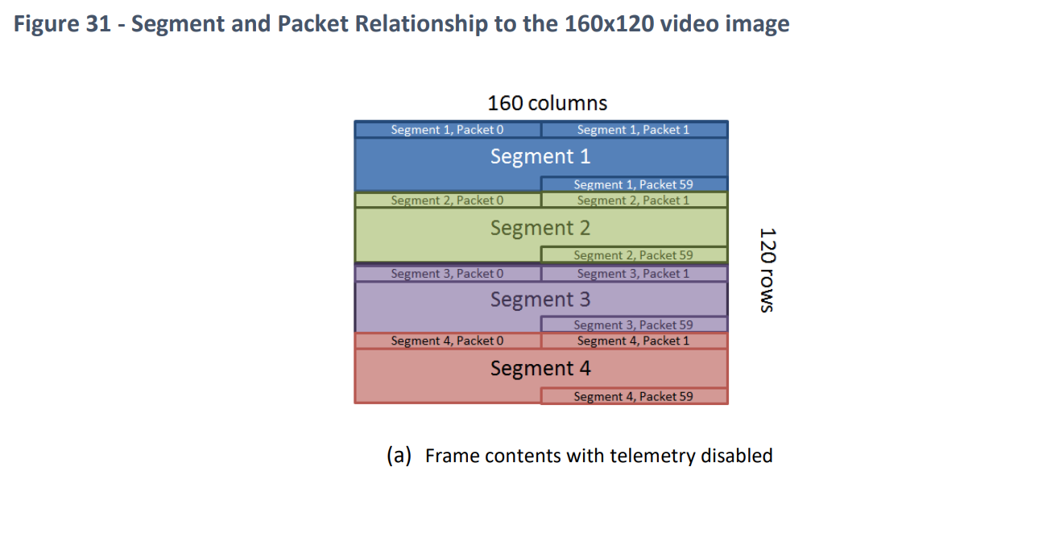
Microcontroller (Blake)
Receiving Camera Data
Each segment has 60 packets with a packet ID from 0-59
Each segment has a segment ID on 20th packet from 1-4
Figure taken from FLiR Lepton Datasheet

Slide 3
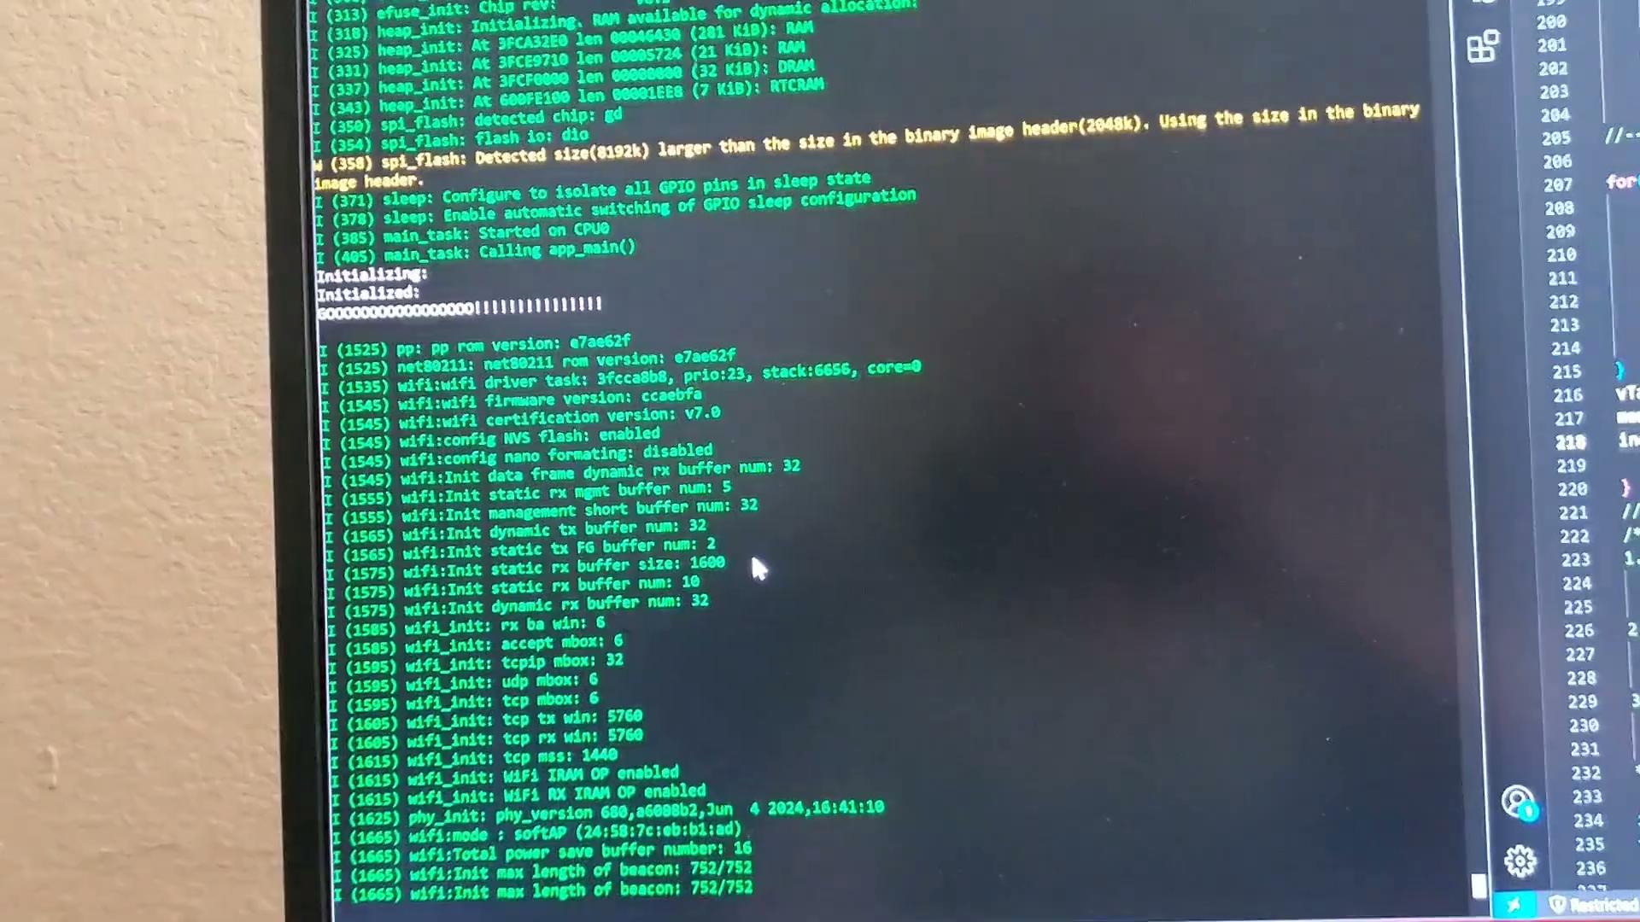
Microcontroller (Blake)

Slide 4
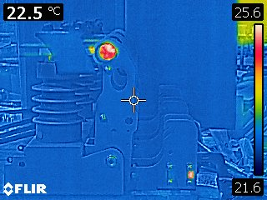
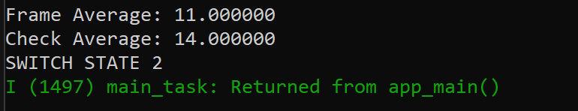
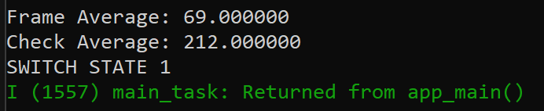
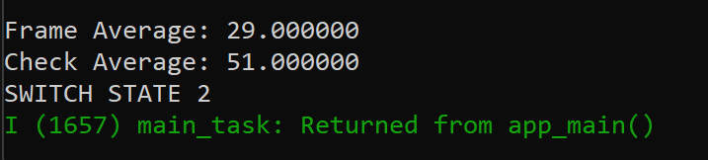
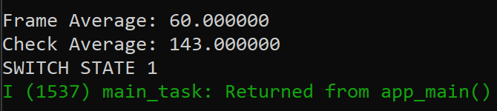
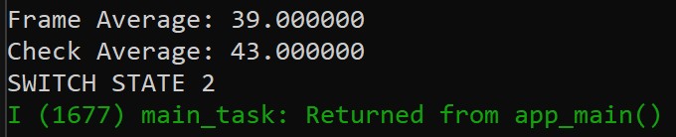
Microcontroller (Blake)
Image Processing
I first normalize the pixel data to an 8-bit mapping (0-255)
Calculate the difference between the average heat of the frame and the designated window
Nothing in frame
Heat in top half
Heat in bottom half
Heat in left half
Heat in right half

